Slide 1
Denver’s Rail System Station Guide
C & D lines
Team Members:
Brendan B., Chris J., Jaron G., Mike F., Vondy M.

Slide 2
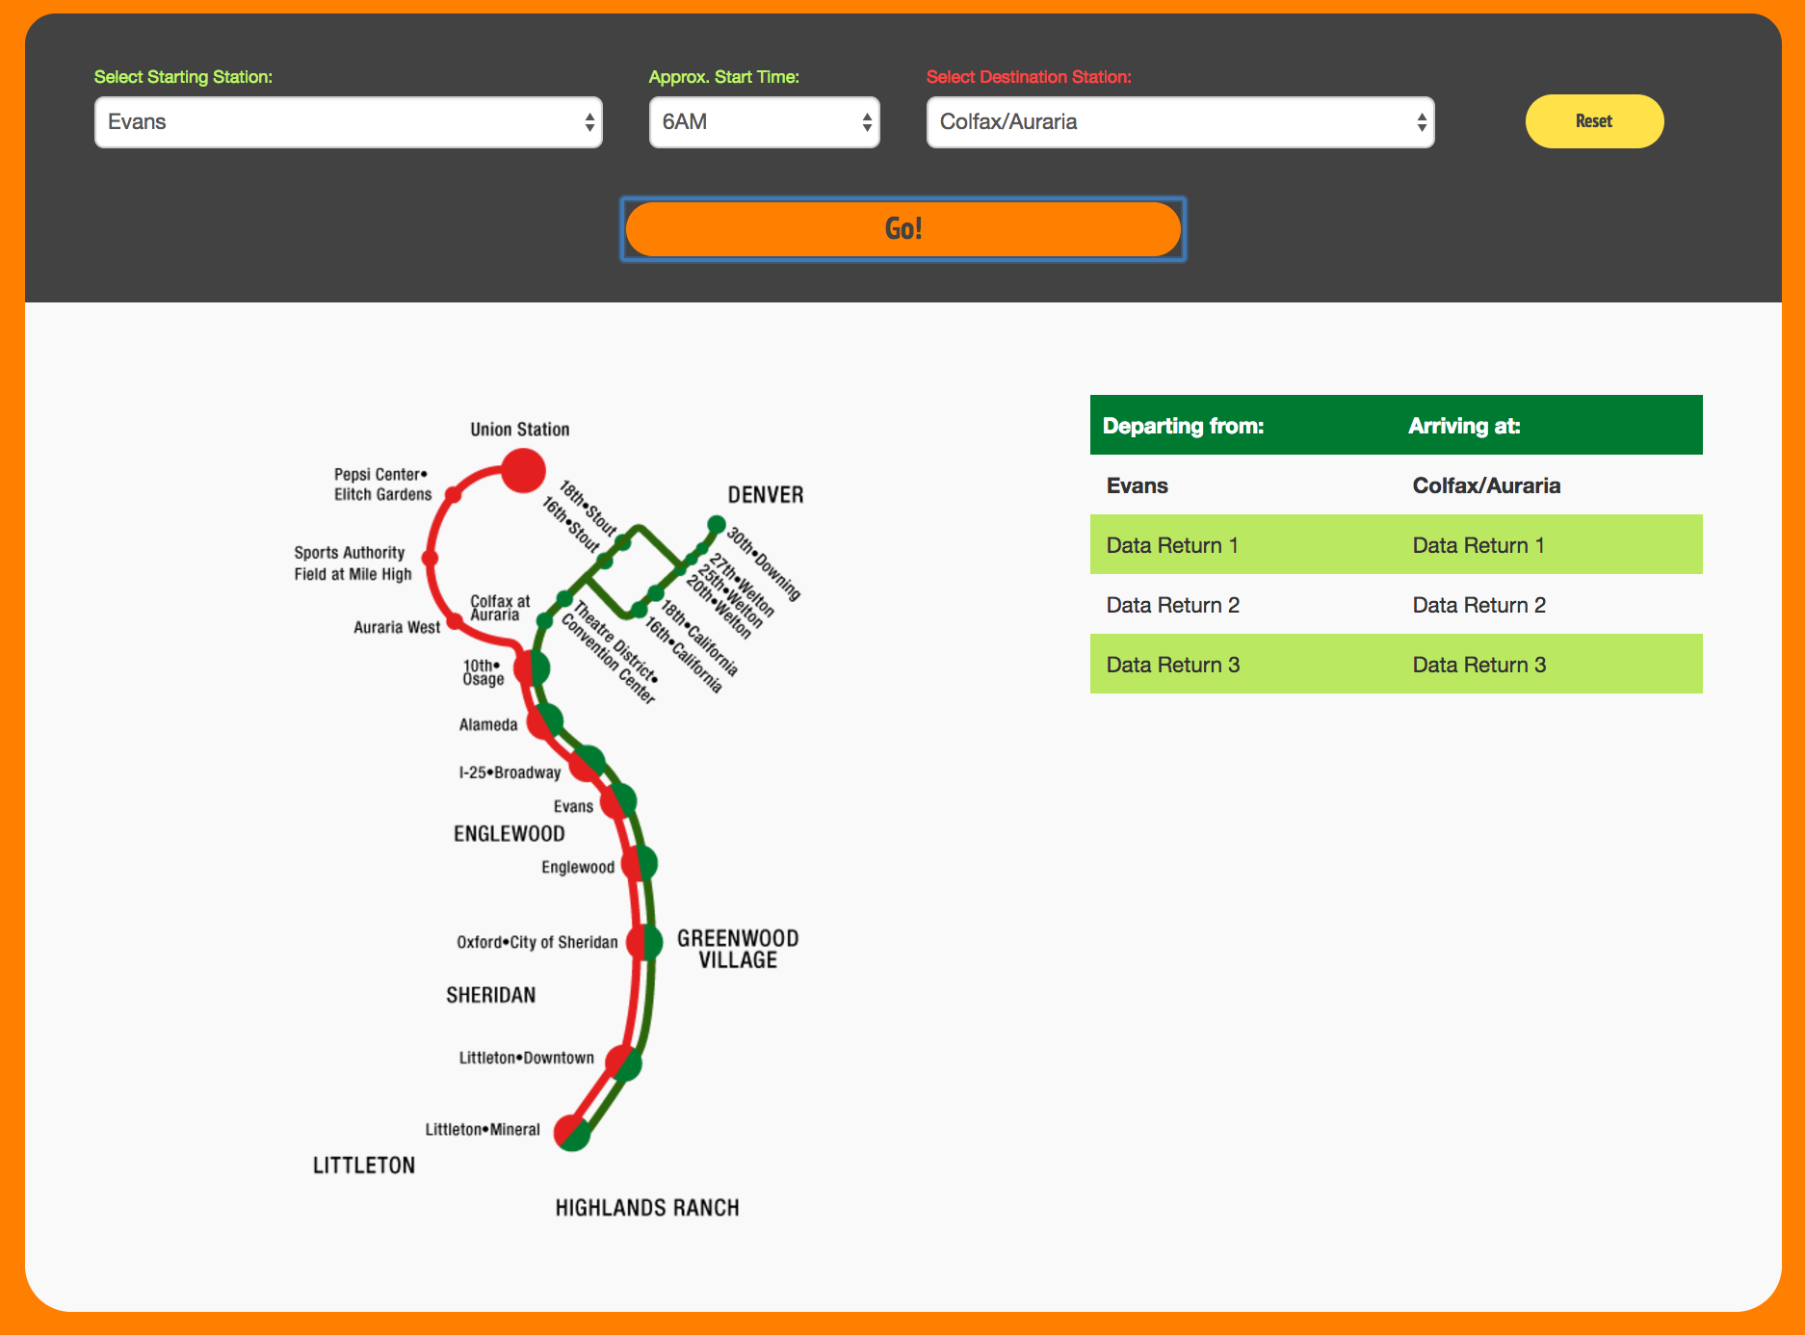
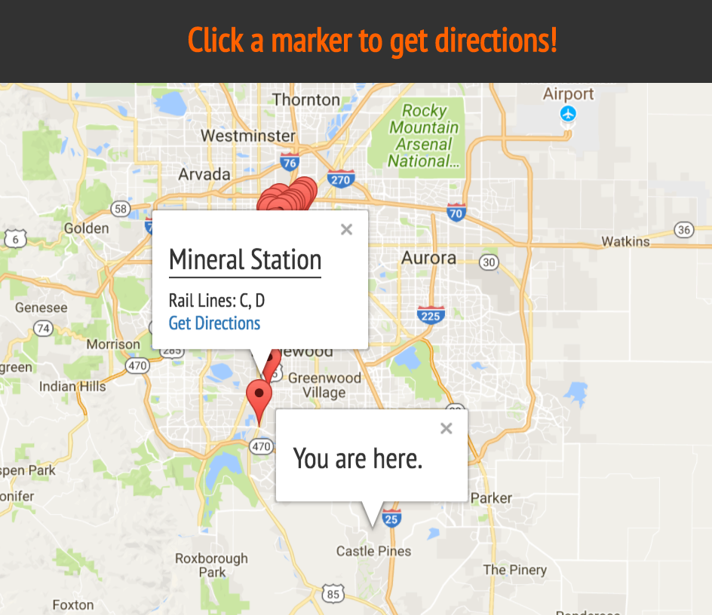
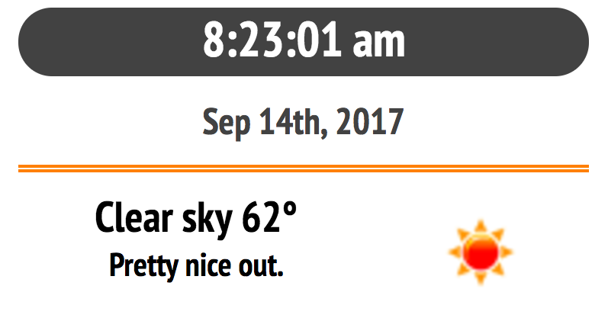
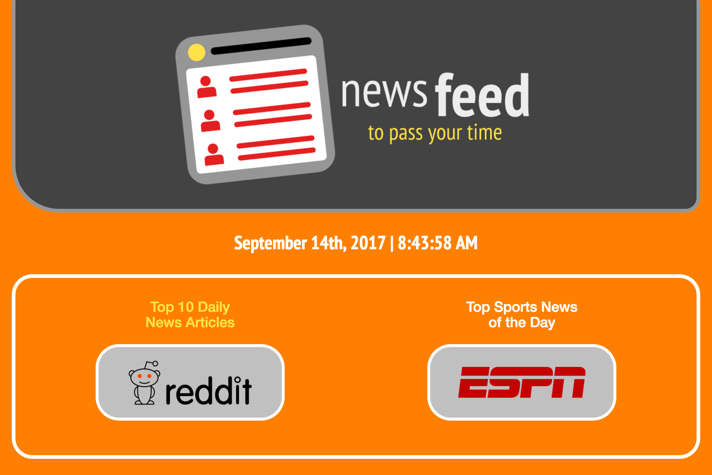
{ Station Guide App Concept }
Station Departure & Arrival Times
Rail Station Locator
Clock & Local Weather
Daily News Feeds

Slide 3


{ App U.I. Design }
Branded
Responsive
Clean & Whimsical

Slide 4
Functionality

Slide 5

{ Time | Date | Weather A.P.I . }
Demonstration

Slide 6
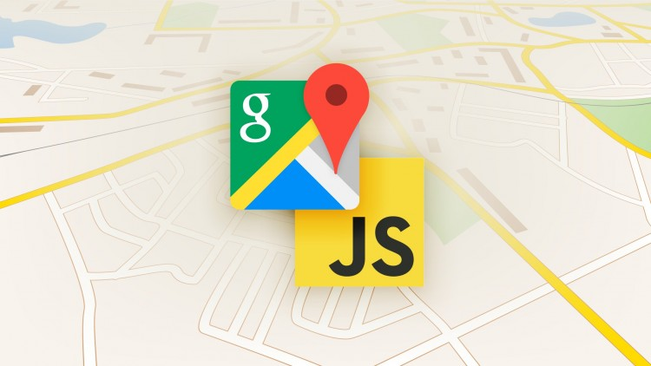
{ Google Maps A.P.I. }
Demonstration

Slide 7

{ News A.P.I. }
Demonstration

Slide 8

{ Database Management }
Demonstration

Slide 9
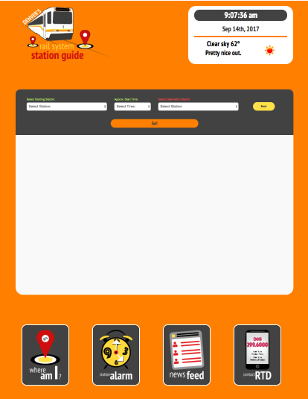





{ Future Development }
> Lines && Train Connections
++ New Technologies
++ Advertising Sales
++ Couponing
Buy 1
meal get 1 FREE
with mention of this coupon.
COMING SOON TO RTD

Slide 10
Questions?

Slide 11
Thank You!

